Slide 1

Towards a Comprehensive Zero Trust Model:
Focusing on Access Management and User Authentication for CIBC

Slide 2
Outline
Introduction
General Overview
Zero Trust Agent
Attribute-Based Access Control
Trust Engine & Applications
Conclusion & Q&A

Slide 3
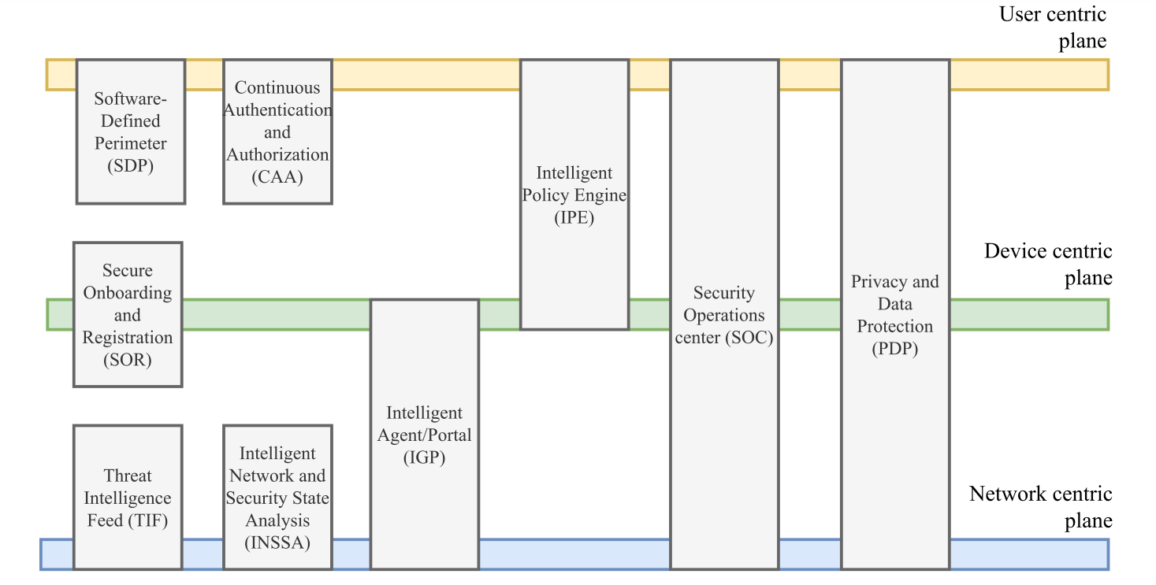
Introduction
Where we left off:
Current State:
Focused Approach: Specialized component of Zero Trust architecture with a focus on access control, user authentication, and trust management.
Practical Implementation and Proof of Concept: Detailed plan for real-world implementation, focusing on specific components that can be developed, tested, and improved upon.
Goal: Taking practical steps towards building a comprehensive ZT model.
Fig. 1 Proposed Intelligent Comprehensive ZT Architecture

Slide 4
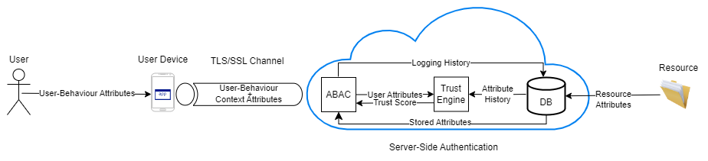
Overview of Proposed Zero Trust Solution
Fig. 2. Proposed Zero Trust Architecture
Attribute-Based Access Control (ABAC): Provides fine-grained control based on user and resource attributes, ensuring trust is never implicitly granted.
Context-Aware User Authentication & Zero Trust Agent: Leverages physical trust relationships and contextual attributes like location and time for dynamic access decisions. The Zero Trust Agent collects user and device attributes, enabling continuous authentication and real-time decision-making.
Trust Engine: Continuously monitors and assesses user trustworthiness using attributes and contextual factors to calculate a trust score.
Adherence to Zero Trust Principles: Ensures thorough evaluation of every access request, adhering to the principles of "never trust, always verify" and "least privilege”.

Slide 5
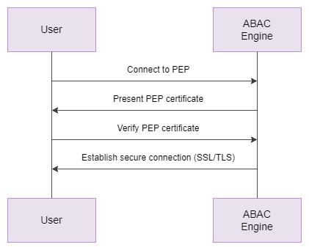
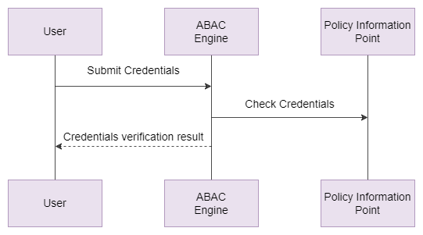
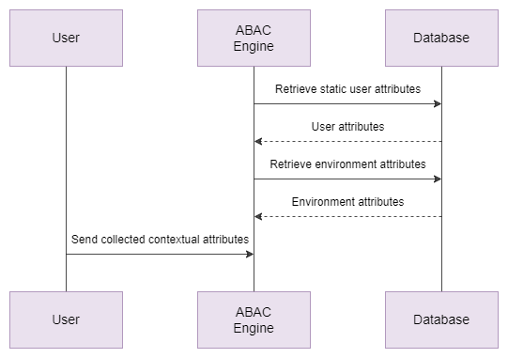
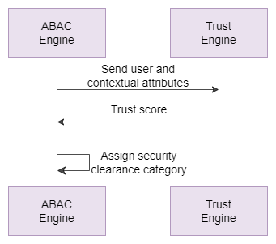
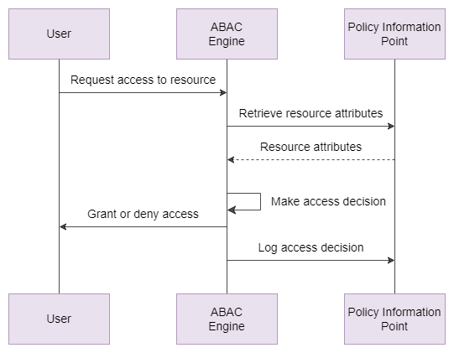
Overview of Proposed Zero Trust Solution
Zero Trust Flow
A. Policy Enforcement Point Authentication
B. Initial User Authentication
C. Attribute Management
D. Trust Calculation
E. Resource Access

Slide 6
Zero Trust Agent

Slide 7

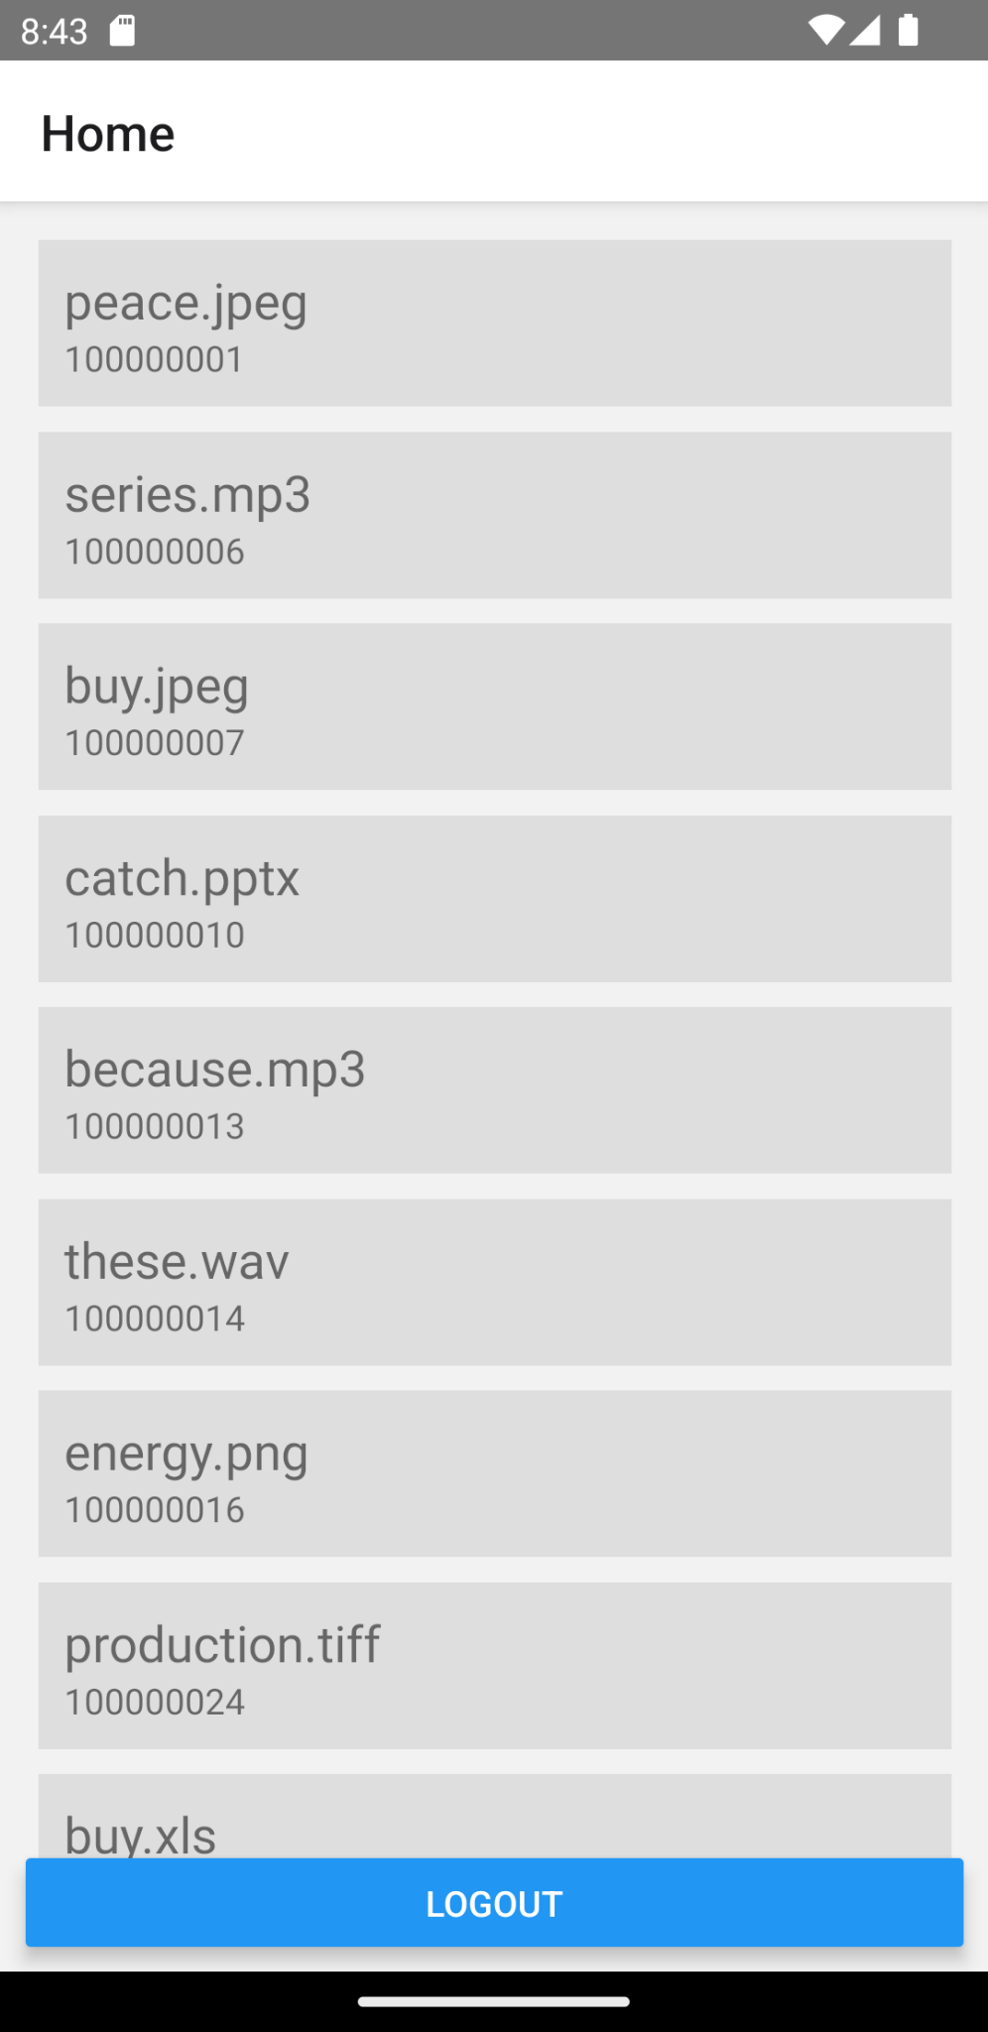
Applet - Context Information
Nearby Access Points
Determine indoor location
Nearby Bluetooth Devices
Fine-grained indoor location
Current Location
Geographic location
Device Information
Include phone status such as battery, memory, is emulator
Device Network Information
Provides IP, MAC Address, connection type
List of Installed Apps
Search for blacklisted apps

Slide 8
Applet - Future Development
Implement additional security measures
Enforce use of biometrics to perform certain actions
Reauthenticate if trust score falls below a set threshold (e.g. using I/K contact [2])
Get user permission to share data
Implement applet as a background service
Applet is currently a normal app where user signs in to perform actions

Slide 9
Attribute-Based Access Control (ABAC)

Slide 10

ABAC
Overview
Definition: ABAC is a fundamental component of Zero Trust solution, providing fine-grained access control based on attributes associated with users, resources, actions, and the environment.
How it Works: Unlike traditional models that assume trust based on identity or role, ABAC evaluates attribute values and applies predefined policies to determine access permissions for each request.
Zero Trust Alignment: In line with the Zero Trust principle of “never trust, always verify,” ABAC ensures that trust is never implicitly granted. Access is only provided when the request satisfies all defined policies, making it a crucial part of implementing a robust Zero Trust architecture.
Flexibility: ABAC allows for flexible access control without directly assigning capabilities, enabling independent management of policies, users, and objects.

Slide 11
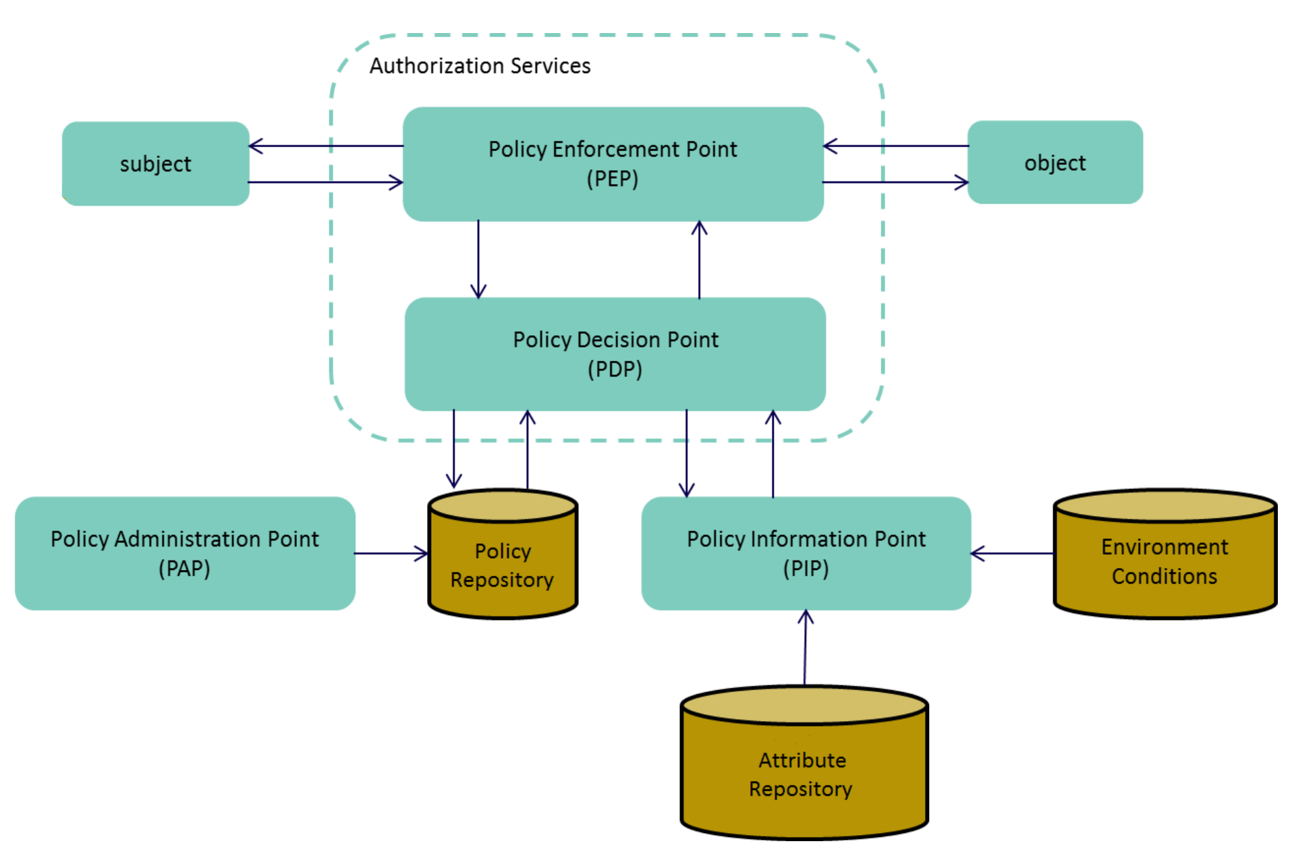
ABAC
Functional Components
Policy Information Point (PIP):
Definition: Central repository for storing and retrieving attributes used in the system.
Functionality: Stores environment attributes, user attributes, and resource attributes.
Policy Decision Point (PDP):
Definition: Manages permissions and access privileges within the system.
Functionality: Utilizes attributes stored in the PIP to make dynamic access control decisions.
Policy Enforcement Point (PEP):
Definition: Enforces the decisions made by the PDP.
Functionality: Receives access requests and enforces the decision of the PDP.
Policy Administration Point (PAP):
Definition: Manages the creation, deletion, and modification of policies.
Functionality: Provides a user interface for administrators to manage policies and rules.
Fig 3. Functional Components of ABAC Setup, Adapted from [1]

Slide 12
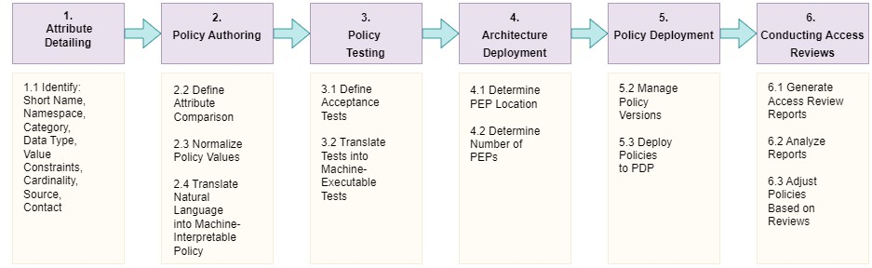
ABAC
Real-World Implementation

Slide 13
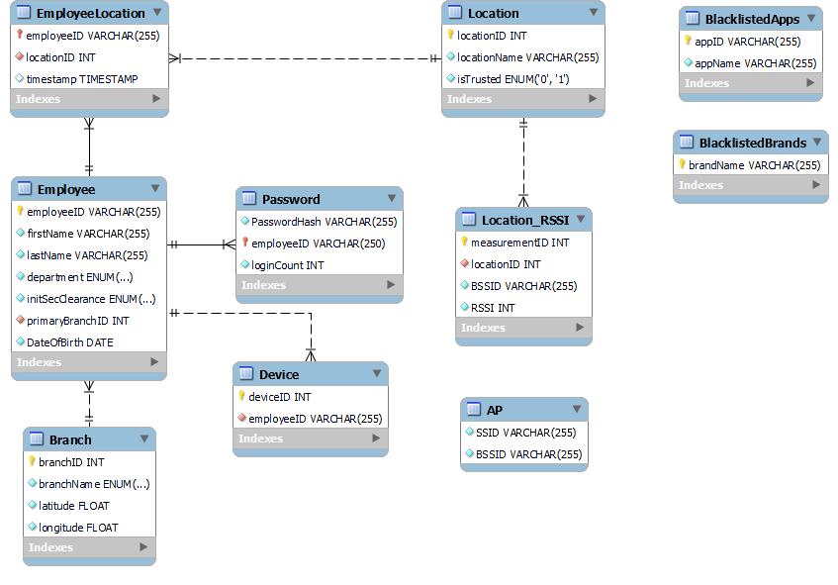
ABAC
Employee Schema: Manages fixed employee attributes, devices, branches, and locations
Location Reference Schema: Used for indoor location fingerprinting
Proof of Concept - PIP
Setup: Implemented in RDS MySQL, the schema is central to the Policy Information Point (PIP).
Security Restrictions Schema: Defines restrictions to uphold organizational security standards.

Slide 14
ABAC
Proof of Concept - PEP
Implementation:
The code is implemented using Flask, a micro web framework in Python, hosted on PythonAnywhere
Intercepting Access Requests: The PEP intercepts every access request, gathering contextual attributes from the device and additional attributes from the Policy Information Point (PIP).
Combining Attributes: Merges static and dynamic attributes into an access request.
Communication with PDP: Sends combined attributes to PDP for evaluation.
Enforcing PDP's Decision: Receives and enforces the decision from PDP
Indoor Location Tracking: The code includes functionality to update the indoor location of an employee based on the RSSI values received from the client. It retrieves BSSID information periodically to keep updating the indoor location.
Authentication and Authorization Control (ATC): The code handles the login process, password setting, and JWT token creation, ensuring proper authentication and authorization.
Resource Retrieval: The code includes a function to retrieve resources that the employee can see based on their initial security clearance.
Functionalities:

Slide 15
ABAC
Proof of Concept - PDP & PAP
Comparison of Development Options
Policy Decision Point (PDP):
Access Request Handling: Intercepts access requests, combines attributes from Azure Trust, PIP, and device (e.g., BSSID information).
Evaluation: Compares access request and attributes against policies.
Communication: Sends evaluation to PDP, receives response, enforces access decision.
Method | Pros | Cons
Custom Development | Complete control, High customizability | Time and resource investment, Requires expertise
Axiomatics | Comprehensive, XACML support | Cost, less customizability
AuthZForce | Open-source, High customizability, API | More setup required
Selection of AuthZForce:
Reason for Choice: Customizable, easy to use, RESTful API for PDP communication, PAP creation through HTTP methods.
Hosting: Deployed on a Virtual Machine (VM) on AWS EC2.
Policy Administration Point (PAP):
Authzforce enables loading policies programmatically using HTTP methods.

Slide 16
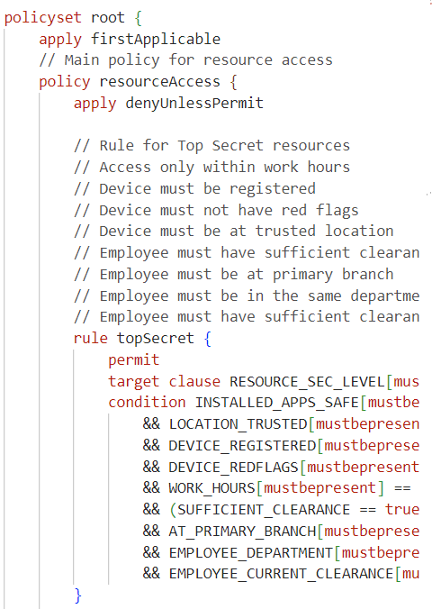
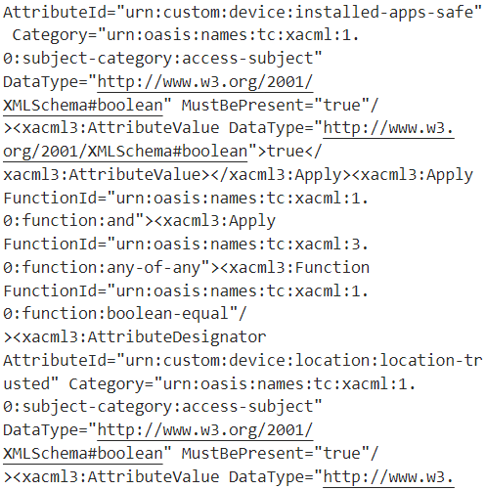
ABAC
Proof of Concept - Policies
Policy Language:
ALFA: Developed by Axiomatics, simple and user-friendly.
Compilation: Automatically compiled to XACML, used by AuthzForce.
Fig 4: Snapshot of ALFA Policy
Fig 5: Snapshot of Compiled XACML Policy

Slide 17

ABAC
Proof of Concept - Policies
Attributes:
Dynamic: INSTALLED_APPS_SAFE, AT_PRIMARY_BRANCH, LOCATION_TRUSTED, DEVICE_REGISTERED, WORK_HOURS, SUFFICIENT_CLEARANCE, DEVICE_REDFLAGS, EMPLOYEE_CURRENT_CLEARANCE.
Static: EMPLOYEE_DEPARTMENT, EMPLOYEE_INIT_CLEARANCE, RESOURCE_DEPARTMENT, RESOURCE_TYPE, RESOURCE_SEC_LEVEL.
Policy Structure:
Hierarchy: Starts very high (restrictive) and gets less strict as it goes down.
Requirements Based on Resource Security Level:
Top Secret: Access within work hours, registered device, trusted location, sufficient clearance, primary branch, matching department.
Secret: Safe apps, trusted location, registered device, no red flags, primary branch, matching department, sufficient clearance.
Confidential: Safe apps, registered device, no red flags, matching department, sufficient initial or current clearance.
Restricted: Safe apps, no red flags, matching department, sufficient initial or current clearance.
Unclassified: Safe apps, no red flags.

Slide 18
Trust Engine

Slide 19
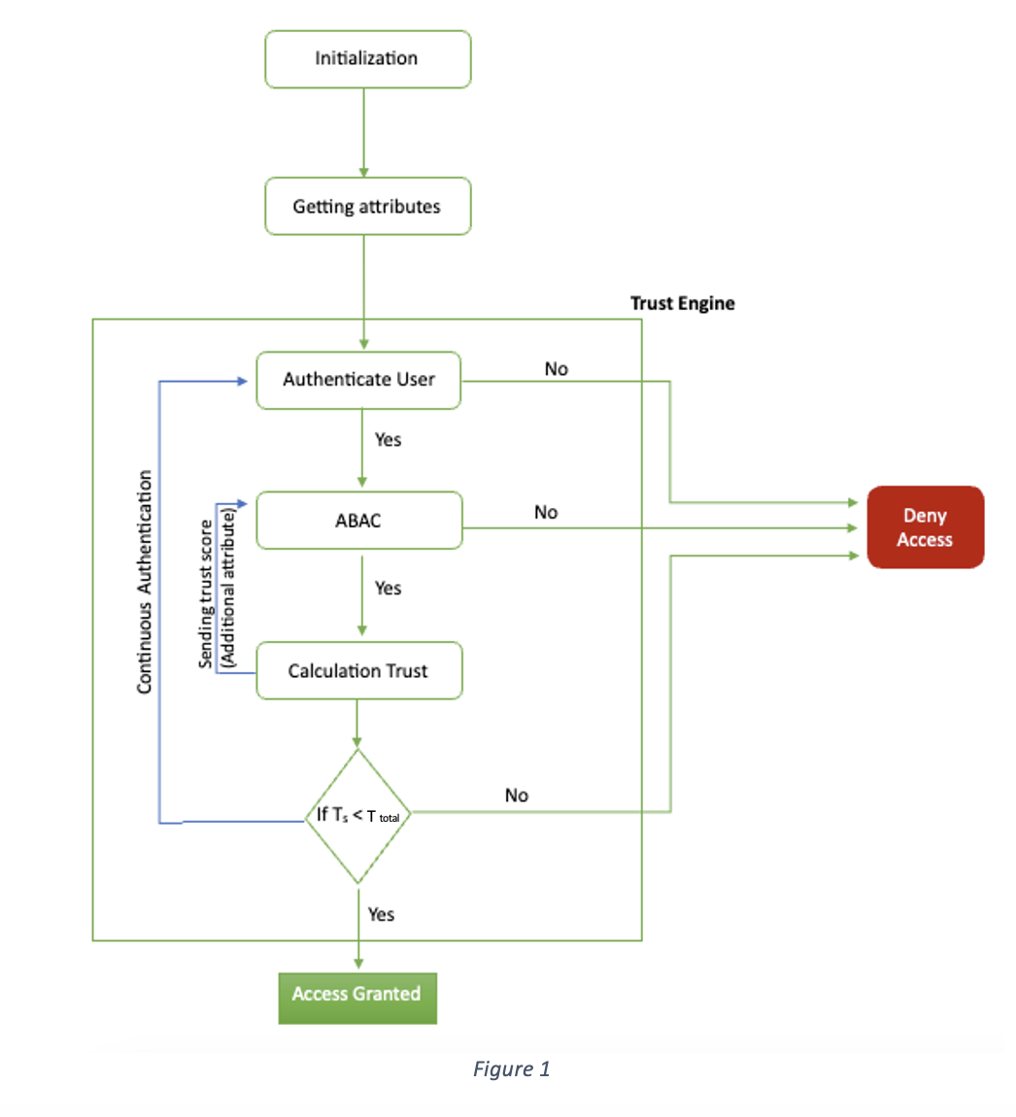
Trust Engine
T _{Total} = T _{B} + T _{C}

Slide 20
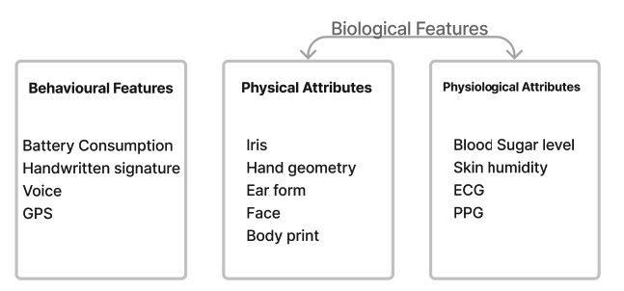
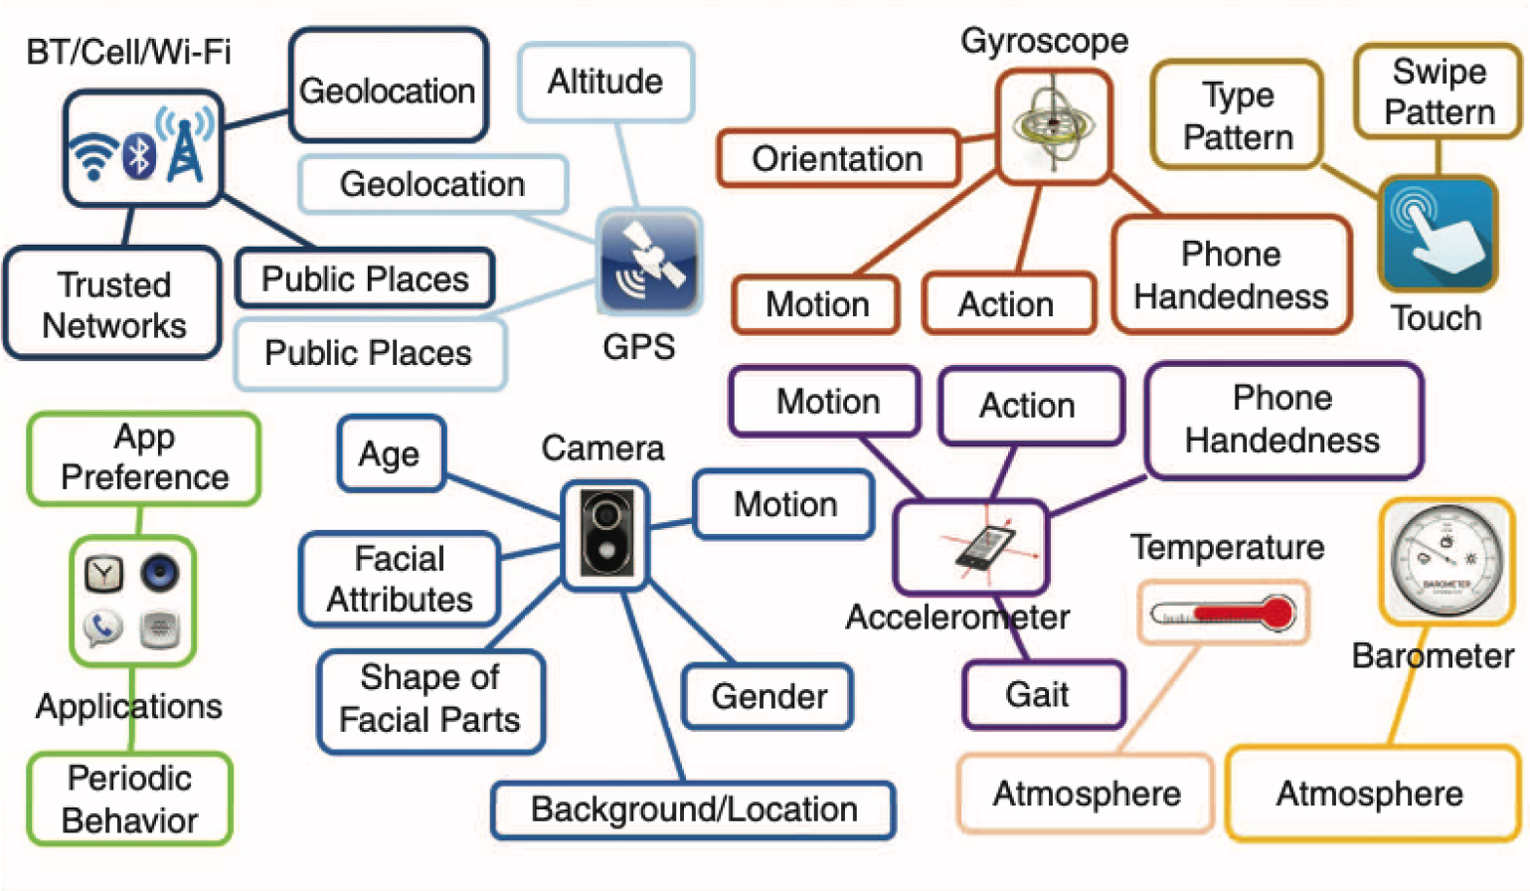
Continuous User Authentication
Periodic Authentication
Passive Biometrics
Risk-Based Check
Token-Based Authentication
Session-Based Authentication
Behavioural Analysis
Device-Based Authentication
Network-Based Authentication
Location-Based Authentication
Time-Based Authentication

Slide 21
Conclusion
Incorporates layers of verification, authentication, and authorization to ensure robust security
Future Work
Self - Learning ABAC
Logging
Enhancement Certificate Authority
Protecting employee’s data based on their sensitivity (Three level model)
Testing and preparing some scenarios based on our needs

Slide 22
References
[1] Chung, D. Ferraiolo, D. Kuhn, A. Schnitzer, K. Sandlin, R. Miller, and
K. Scarfone, “Guide to attribute based access control (abac) definition
and considerations,” 2019-02-25 2019.
[2] S. Arimura, M. Fujita, S. Kobayashi, J. Kani, M. Nishigaki, and A. Shiba,
“i/k-contact: A context-aware user authentication using physical social
trust,” in 2014 Twelfth Annual International Conference on Privacy,
Security and Trust, pp. 407–413, 2014 [3] D. Elliott Bell, Bell–La Padula Model, pp. 74–79. Boston, MA: Springer US, 2011. [4] D. Brossard, G. Gebel, and M. Berg, “A systematic approach to imple- menting abac,” pp. 53–59, 03 2017.
[5] S.Arimura,M.Fujita,S.Kobayashi,J.Kani,M.Nishigaki,andA.Shiba, “i/k-contact: A context-aware user authentication using physical social trust,” in 2014 Twelfth Annual International Conference on Privacy, Security and Trust, pp. 407–413, 2014.
[6] A. Jøsang, Subjective Logic: A Formalism for Reasoning under Un- certainty. Artificial Intelligence: Foundations, Theory, and Algorithms, Cham: Springer International Publishing AG, 2016.
[7] T. Lukaseder, M. Halter, and F. Kargl, “Context-based access control and trust scores in zero trust campus networks,” 2020.
[8] Fiware, “Authzforce community edition,” 2023. Accessed: 2023-08-04.

